Slide 1
Titanic Dataset
Visualisation

Slide 2
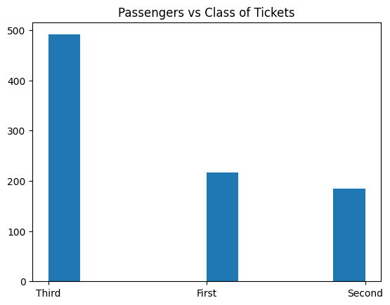
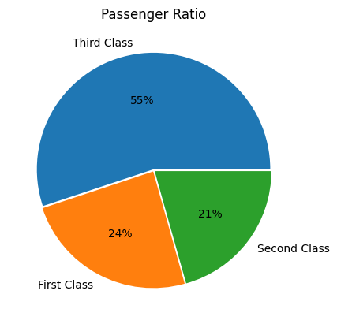
Titanic – Dataset Insights
Passenger Ratio :
First Class – 24 %
Second Class – 21 %
Third Class – 55 %

Slide 3
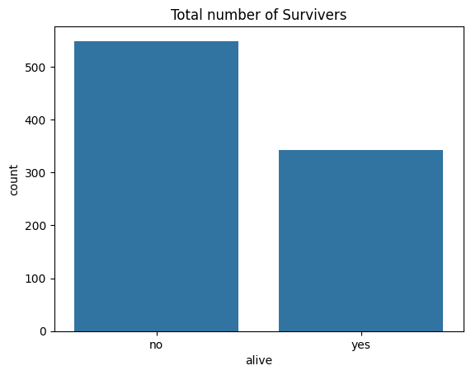
Survivors
More than half of the passengers drowned when the ship sank.

Slide 4
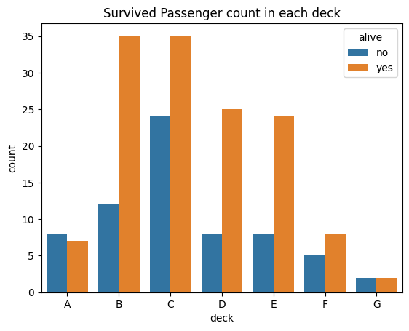
How the Survivors are categorised ?
Passengers near the decks B, C, D & E were able to escape easily when the ship hit the iceberg.

Slide 5
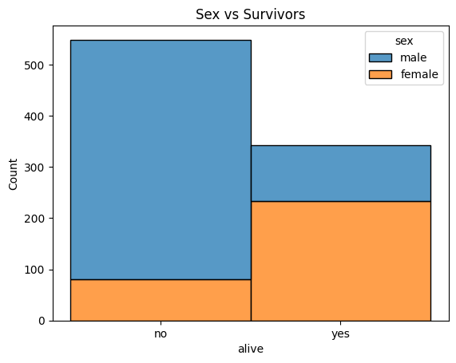
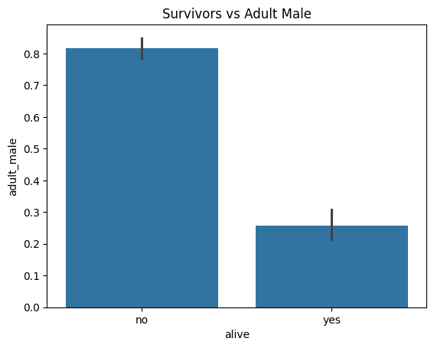
How the Survivors are prioritised?
Mostly women and children were given first preference.

Slide 6
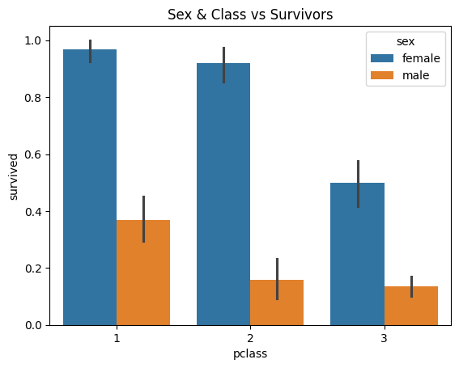
How wealth played a role ?
The people in 1st class mostly survived but the 3rd class female survivors are more than that of 1st class male survivors, which says about prioritising women and children.

Slide 7
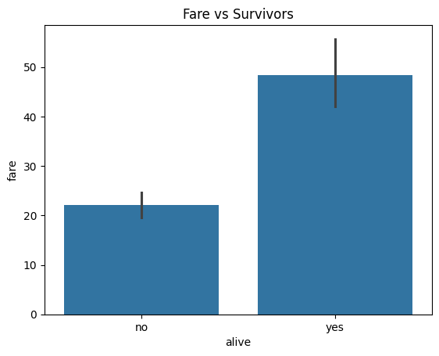
How wealth played a role ?
But despite the preference to women and children, almost everyone who paid more for the journey were among the survivors.

Slide 8
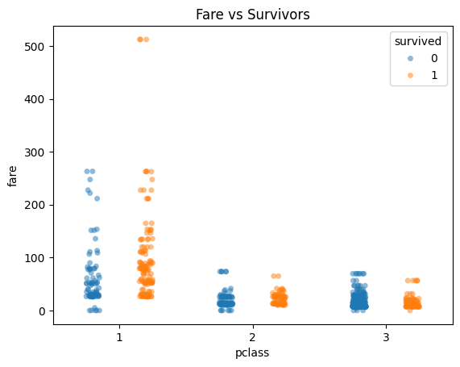
Did wealth play a role ?
Here, the people who paid the highest fare survived somehow.

Slide 9
Thank You

